Slide 1
Significant Figures and Measurements

Slide 2
Part 1: Significant Figures

Slide 3
Types of Numbers
In the world of science, there are two types of numbers:
  Exact numbers – Numbers you know with certainty (counting numbers). For example, there are exactly 28 student seats in my classroom.
  Approximate numbers – Numbers that are derived from a measurement. For example, height of a person.
In terms of significant figures, exact numbers have INFINITE SIG FIGS because they are definite, exact.
  There are exactly 28.00000000000……….0 student seats in my classroom
In contrast, approximate numbers have VARIABLE SIG FIGS because they depend on the device that was used for making the measurement.
  The height of a person is more precise with a meter stick than by using, say, the bricks on a wall.

Slide 4
Types of numbers
To a mathematician the numbers 21.7 and 21.70 convey similar things.
To a scientist however, these numbers are different. The second measurement is more precise and we are more certain about its value.

Slide 5
Review – Rules For Sig Figs
There are four major rules in the world of sig figs:
Rule #1 – Anything not a zero is ALWAYS significant because it had to be measured to be determined.
Rule #2 – Leading zeroes (zeroes before the first non-zero number) are NEVER significant because they were never actually measured. They are placeholders.
Ex: 0021 has 2 sig figs. 0.00021 has 2 sig figs. In both cases the zeroes were not measured but are simply there to indicate place value.

Slide 6
Review – Rules For Sig Figs
Rule #3 – Sandwiched zeroes (zeroes between two non-zero numbers) are ALWAYS significant because they were measured.
Ex: 203 has 3 sig figs because the “0” had to be measured. 2003 has 4 sig figs because both “0”s had to be measured.
Rule #4 – Lagging zeroes (zeroes after the last non-zero) are SOMETIMES significant. If there is a decimal, they are. If there isn’t a decimal, they aren’t.
Ex: 2000 has 1 sig fig but 2000. has 4 sig figs. The presence of a decimal indicates they were measured.

Slide 7
Try THESE
How many significant figures do the following numbers have?
99.10
0.007600
56200
8.26 x 10⁻⁷
7 x 10⁵
Hint: The last two are tricky. Think about what scientific notation means.

Slide 8
Review – Multiplying/Dividing with Sig Figs
When you are performing a multiplication or division problem, it is important that your answer conveys the appropriate number of sig figs.
The rule for multiplying or dividing with sig figs is that your answer (your output) needs to have the same number of sig figs as the lowest number of sig figs in the numbers you are using (your inputs).
Ex: 9.4 x 10 = 94 = 90 (9.4 has 2 sig figs, 10 has 1 sig fig therefore the answer can have only 1 sig fig)

Slide 9
Review – Adding and subtracting with Sig Figs
When adding or subtracting with sig figs, the number of significant figures does not matter. Instead, the precision of the sig figs (where the sig figs end) determines where to round in the answer.
Rule: Round your answer (your output) to the same precision as your least precise input
Ex: 0.56 + 0.153 = 0.713 = 0.71 (0.56 ends in the hundredths, 0.153 ends in the thousandths. Hundredths is least precise so round answer to hundredths)

Slide 10
Special Rounding Rule
In chemistry we use a special rounding rule when the digit to be rounded is exactly 5.
  If the number preceding the 5 is even, round down. If the number preceding the 5 is odd, round up.
This rule originates because an exact 5 is in a position of stasis between the common rules of “less than 5, round down” and “greater than 5, round up”. Doing it this way ensures that have the time, the answer is rounded down and the other half, it is rounded up.
Ex: 9.5 x 10 = 95 = 100 but 8.5 x 10 = 85 = 80

Slide 11
Try THESE
Perform the following operations
9.10 + 53.2
1030 / 10
1345 + 10.0
1.750 x 1.54 x 3.68
12.3 + 11 + 20

Slide 12
Mixed Operations Problems
If you have a problem that involves adding/subtracting with multiplying/dividing, do the sig figs in the same order you would do the order of operations.
Ex: 8.52 + 4.1586 x 18.73 + 153.2 =
8.52 + 77.89 + 153.2 = 239.61 = 239.6

Slide 13
Try this
(8.52 + 4.1586) x (18.73 + 153.2) = ?

Slide 14
Part 2: Making Measurements

Slide 15
Making a good measurement
A good measurement is one that conveys all the appropriate information needed in the most accurate and precise way. To that end, a good measurement always involves three parts:
  Units
  Correct Precision
  Uncertainty

Slide 16
Units
Units are important because they provide a sense of scale. For instance if I told you something was 13 long, that is very vague. You have no context to tell if a length of 13 is very big or very small. Units provide that context for us.

Slide 17
Correct Precision
When we make a good measurement, we want to convey as much information as possible (precision).
Rule: Your measurement should go one place beyond what is marked (with the exception of a digital device).

Slide 18
The orange box is best described as being 3.95 cm long. Saying it is 4 does not convey the appropriate precision because we can tell it isn’t quite 4. Saying 3.9 is also imprecise because we can tell its greater than the 0.9 but less than the full 1

Slide 19
Uncertainty
Because we estimate the last place in a measurement there is always some uncertainty in our answer. The magnitude of the uncertainty is equal to ± half the smallest increment on the measuring tool if an analog device or ± the smallest increment on the measuring tool for a digital device.
Going back to the orange box, the full measurement would thus be 3.95 ± 0.05 cm because the meter stick measures to the tenths and half a tenth would be 0.05.
  This ± 0.05 cm is called the absolute uncertainty
Sometimes, the uncertainty will be marked on the instrument (especially for glassware). Use this uncertainty in your measurement.

Slide 20
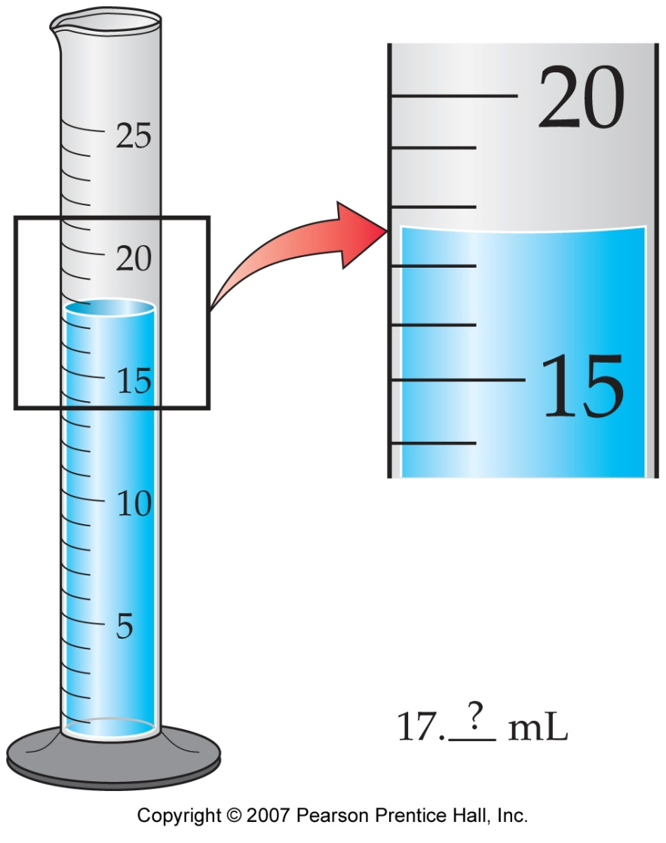
Measuring Volume
When measuring volume in a piece of glassware, always measure from the meniscus (the lowest part of the curve)
Ex on Right: 17.5 ± 0.5 mL

Slide 21
Propagating Uncertainty
In the IB sciences, especially chemistry, we are responsible for keeping track of various uncertainties and carrying them through calculations. This is called “propagating uncertainty”.
There are two simple rules for propagating uncertainty, one for adding/subtracting and one for multiplying/dividing.

Slide 22
Adding/Subtracting with Uncertainty
When you are performing an addition or subtraction operation, you simply add the absolute uncertainties of the two (or more) numbers that you are adding/subtracting.
For example:
  Let’s say I have a rectangle that measures 12.50 ± 0.05 cm in width and 5.60 ± 0.05 cm in height and I wanted to find the perimeter of the rectangle:
  Perimeter = Width + Width + Height + Height = 12.50 cm + 12.50 cm + 5.60 cm + 5.60 cm = 36.20 cm
  Uncertainty of Perimeter = 0.05 cm + 0.05 cm + 0.05 cm + 0.05 cm = 0.20 cm
  Final result = 36.20 ± 0.20 cm

Slide 23
Multiplying/Dividing with Uncertainty
When multiplying and dividing with uncertainties, you first must convert the absolute uncertainty into a percent uncertainty. This can be done by taking the absolute uncertainty, dividing it by the actual measurement, then multiplying by 100 (since it’s a percent).
Once you have the different percent uncertainties, you must add them to find the final percent uncertainty.
Lastly, you must apply that uncertainty to the answer of the multiplication/division to convert it back to an absolute uncertainty.

Slide 24
Multiplying/Dividing with Uncertainty
Let’s consider the same rectangle from earlier (width = 12.50 ± 0.05 cm and height = 5.60 ± 0.05 cm) and try to find it’s area
Area of a rectangle = W x H = 12.50 cm x 5.60 cm = 70.0 cm²
Percent Uncertainty of Width = ( 0.05 cm / 12.50 cm ) * 100 = 0.4 %
Percent Uncertainty of Height = ( 0.05 cm / 5.60 cm ) * 100 = 0.893%
New Percent Uncertainty = 0.4% + 0.893% = 1.293%
New Absolute Uncertainty = ( 70.0 * 1.293) / 100 = 0.905 = 0.9 cm²
Final answer: 70.0 ± 0.9 cm²

Slide 25
What about when you have both types of operations??
You follow the order of operations!!
Ex: Let’s assume we wanted to find the density of an irregular shaped piece of metal. We know it’s mass is 12.400 ± 0.001 g (as measured by a digital balance). To find it’s volume, we will use the water displacement method. We fill a graduated cylinder to 10.0 ± 0.5 mL. After putting the piece of metal in, the new volume is 11.8 ± 0.5 mL.
Density = Mass / Volume
Density = 12.400 ± 0.001 g / (11.8 ± 0.5 mL – 10.0 mL ± 0.05 )
Density = 12.400 ± 0.001 g / (1.8 ± 1.0 mL)
Density = 6.9 g/mL
Percent Uncertainty of Mass = ( 0.001 g / 12.400 g) * 100 = 0.0081%
Percent Uncertainty of Volume = ( 1.0 / 1.8 ) * 100 = 55.5556%
Total Percent Uncertainty = 55.5641%
New Absolute Uncertainty = (6.9*55.5641)/100 = ± 3.8339 mL ± 3.8 g/mL
Final Answer: 6.9 ± 3.8 g / mL

Slide 26
Why do we care about uncertainty…..revisited
Look at that answer again…..A density of 6.9 ± 3.8 g/mL. What does that mean again?
  The density could be as low as 3.1 g/mL OR could be as high as 10.7 g/mL. That’s a huge spread!
By including the uncertainty we indicate our confidence (or lack thereof in this case) in our calculations and thus our experimental procedure.
How do we increase our certainty in our experimentally determined density? We have to reflect on our experimental design and make it better!
Looking back at our calculations, we can see that the main issue was our volume measurement. It had a large uncertainty. So the easiest solution would be to use a graduated cylinder that was marked with more lines (a more precise instrument of measurement).

Slide 27
Part 3: Accuracy, Precision, and How to Quantify them

Slide 28
Definitions
Accuracy is defined as how close your measurement is to the true value of the measurement.
  Best way to think of it: How close are you to the “bullseye”
Precision is defined as how consistent our values our for the same measurement. Ideally, they should be clustered close together with very little spread.
  Best way to think of it: How close together are your shots?

Slide 29
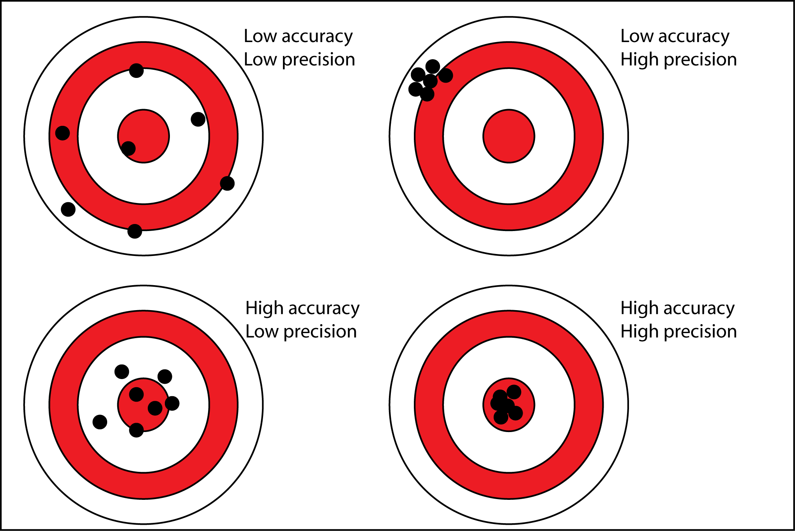

Slide 30

Calculating Accuracy
The statistic used to calculate accuracy is called percent error. The formula for percent error is:
$$\% error= \frac{\left|Actual value −experimental value\right|}{actualvalue}∗100$$
Where “Actual Value” = the true theoretical value as cited by textbooks or scientific literature or someone of authority and “Theoretical Value” = the average value you obtained as a result of your lab.

Slide 31
Calculating Precision
The statistic used to calculate precision is called standard deviation (STD). There are two types of standard deviation though:
  Population standard deviation: use this when you have data on the entire population or a large enough sample size to closely resemble the population
  Sample standard deviation: use this when you have data but it is a small sample size relative to the population.
Most of the time we will be utilizing sample standard deviation.

Slide 32


Formulas for Pop. And Sample STD
$$s=\sqrt{\frac{Σ {\left(X − \overline{X}\right)}^{2}}{n}}$$
$$s=\sqrt{\frac{Σ {\left(X − \overline{X}\right)}^{2}}{n−1}}$$
Where
s = population std
X = a measurement
Xbar = average of measurement
n = the number of samples
Where
s = sample std
X = a measurement
Xbar = average of measurement
n = the number of samples

Slide 33

More about STD and introduction to rsd
A standard deviation calculation will have the same units as the measurement in the calculation.
Interpreting a standard deviation value can be difficult so instead we often calculate the relative standard deviation (RSD) instead. This calculates the std as a percent relative to the mean.
$$RSD= \frac{s}{\overline{X}}∗100$$

Slide 34
What should we aim for?
The lower the better on both!
  Ideally, percent error will be less than 5% and RSD will be less than 3%
  If your STD is close to your mean or there is overlap between data points because of the STD, this means the precision is too low to talk about it being significant with confidence.

Slide 35
Sources of Error
If we have a larger than ideal percent error or RSD, it is important to talk about what errors may have impacted them.
These errors fall into two categories:
  Random: things you can’t control (ex: wind blowing, or uneven heat transfer)
  Systematic: things you can control (ex: Your value is off by 10 at all points because the balance you used was not calibrated properly)

